Slide 1
Scanning Networks

Slide 2
Networks Scanning
A set of procedures for identifying host, ports & services in a network
The components of intelligence gathering an attacker uses to create profile of the target
Objectives
To discover live hosts, IP addresses & open ports of live hosts
To discover operating system & system architecture
To discover services running on hosts
To discover vulnerabilities in live hosts
TCP Communication Flags
URG (Urgent)
Data contained in the packet should be processed immediately
PSH (Push)
Sends all buffered data immediately
FIN (Finish)
There will be no more transmission
ACK (Acknowledgement)
Acknowledges the receipt of a packet
RST (Reset)
Resets a connection
SYN (Synchronize)
Initiates a connection between hosts

Slide 3
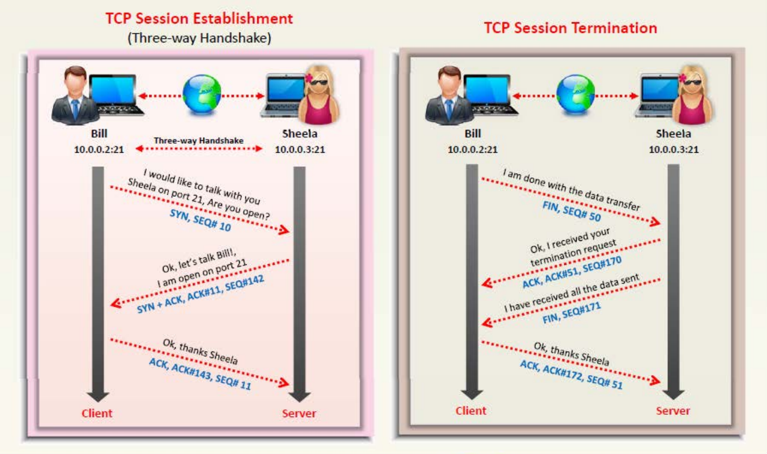
TCP/IP Communication

Slide 4
ICMP Scanning
Ping Sweep
SSDP Scanning
Sending ICMP ECHO requests to a host
Useful for locating active devices or determining if ICMP is passing through firewall
Determine the live hosts from a range of IP addresses
Calculate subnet mask to identify the number of hosts in the subnet
Then use ping sweep to create an inventory of live system in the subnet
Protocol that works in conjunction with uPnP to detect plug & play devices
Vulnerabilities may allow to launch Buffer overflow or DOS attacks
Use uPnP SSDP M-Search tool to check if the machine is vulnerable

Slide 5
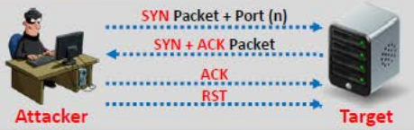
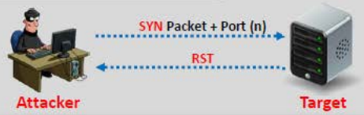
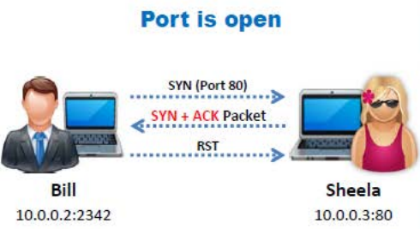
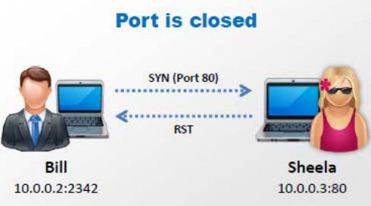
TCP Connect / Full Open Scan
Stealth Scan / Half Open Scan
Detects when port is open by completing 3-way handshake
Establish a full connection and end it by a RST packet
Doesn’t require superuser privileges
Port is Open
Port is Closed
Resetting the connection between the client & server abruptly before completing 3-way handshake
Use to bypass firewall rules, logging mechanism & hide as network traffic

Slide 6


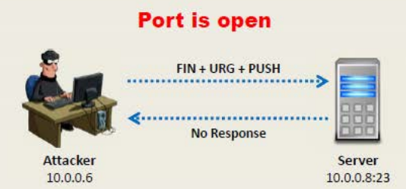
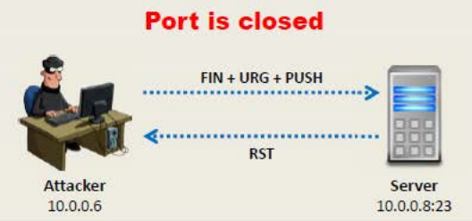
Xmas Scan
Inverse TCP Flag Scan
TCP probe packets with a TCP flag (FIN,URG,PSH) set or with none
No response means port open & RST means port closed
Send FIN, URG, PSH flags set to remote device
Only works on RFC-793 based implementation based OSes
Won’t work against current version of Microsoft Windows

Slide 7
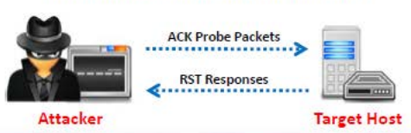
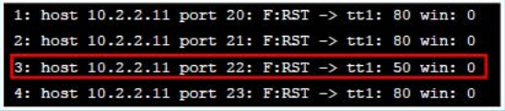
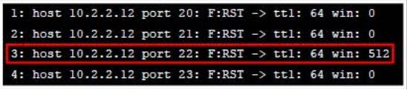
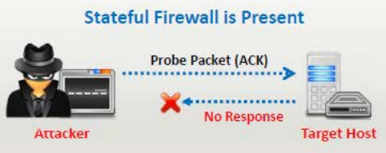
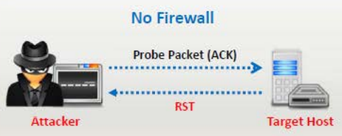
ACK Flag Scan
Send TCP probe packets with ACK flag set
Analyzes the header information of received RST packet
Types:
TTL based
Window based
Used to check the filtering system of the target
No response means port is filtered
RST response means port is not filtered

Slide 8

IDLE/IPID Header Scan
Step 1
Send SYN+ACK packet to the zombie to probe its IPID
IPID increases everytime when a host sends IP packet
Zombie will send RST packet disclosing the IPID
Analyze RST packet to extract IPID

Slide 9
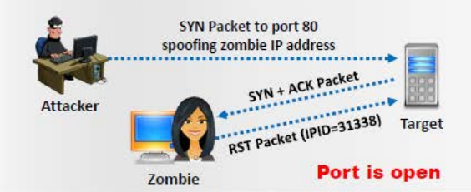
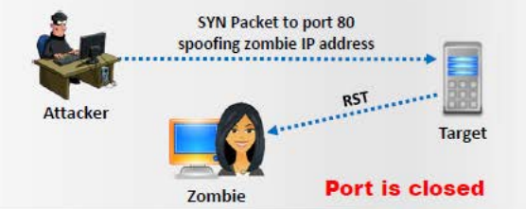
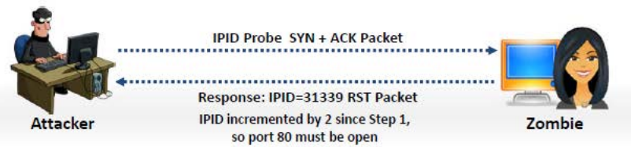
IDLE/IPID Header Scan
Step 2
Send SYN packet by spoofing IP address to the target machine(Port 80)
If the port is open, target will send SYN+ACK packet to zombie & zombie will response with RST
If the port is closed, target will send RST packet to zombie
Step 3
Probe “zombie IPID” again

Slide 10

UDP Scan
No 3-way TCP handshake
Port Open
System doesn’t response with a message
Port Closed
System responds with ICMP port unreachable message
ICMP Echo Scan
Not a port scanning, since ICMP doesn’t have port abstraction
Useful to determine which hosts in a network are up by pinging them all
nmap -P cert.org/24 152.148.0.0/16
List Scan
Simply generates and prints a list of IPs/Names without actually pinging them
A reverse DNS resolution is carried out to identify the host names

Slide 11
Port Scanning Countermeasures
IDS Evasion Techniques
Configure firewall & IDS rules to detect & block probes
Run the port scanning tools against hosts on the network to determine whether the firewall detects the port scanning activity
Ensure the mechanism used for routing & filtering at the routers & firewalls cannot be bypassed
Ensure the router, IDS & firewall firmware are updated
Use custom rule set to lock down the network & block unwanted ports at the firewall
Filter all ICMP messages at the firewalls and routers
Perform TCP & UDP scanning along with ICMP probes against your organization’s IP address space to check the network configuration & its available ports
Ensure the anti-scanning & anti-spoofing rules are configured
Use fragmented IP packets
Spoof your IP address when launching attack & sniff responses from server
Use source routing (if possible)
Connect to proxy servers or compromised trojaned machines to launch attacks

Slide 12
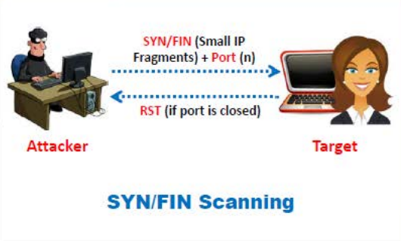
SYN/FIN Scanning Using
IP Fragments
Modification of earlier methods
TCP header is split into several packets to avoid the detection of packet filters

Slide 13
Banner Grabbing
Method to determine the operating system running on a remote target system
Allows an attacker to figure out the vulnerabilities the system posses & the exploits that might work
Active Banner Grabbing
Specially crafted packets are sent to remote OS & the responses are noted
Responses are compared with a database to determine the OS
Responses form OSes varies due to differences in TCP/IP stack implementation
Passive Banner Grabbing
Banner grabbing from the error messages
Sniffing the network traffic
Banner grabbing from page extension
Tools
ID Serve
Used to identify the make, model & version of any website’s server software
Used to identify non-HTTP Internet Services like FTP, SMTP, POP, NEWS etc.
Netcraft
Reports a site’s operating system, web server & netblock
Netcat
Reads & writes data across network connections, using TCP/IP protocol
Telnet
Probes HTTP servers to determine the server field in the HTTP response header

Slide 14
Banner Grabbing Countermeasure
Disabling or Changing Banner
Display false banners to misguide attackers
Turn of unnecessary services on the network host
Use ServerMask tools to disable or change banner information
Apache 2.x with mod_headers module - use a directive httpd.conf file to change banner information Header set Server “New Server Name”
Alternatively, change the ServerSignature line to ServerSignature Off in httpd.conf file
Hiding File Extensions from Web Pages
Hide file extension to mask the web technology
Change application mappings such .asp to .htm to disguise the identity of servers
Apache users can use mod_negotiation directives
IIS user can use PageXchanger to manage file extension
It is even better if the file extensions are not all used

Slide 15
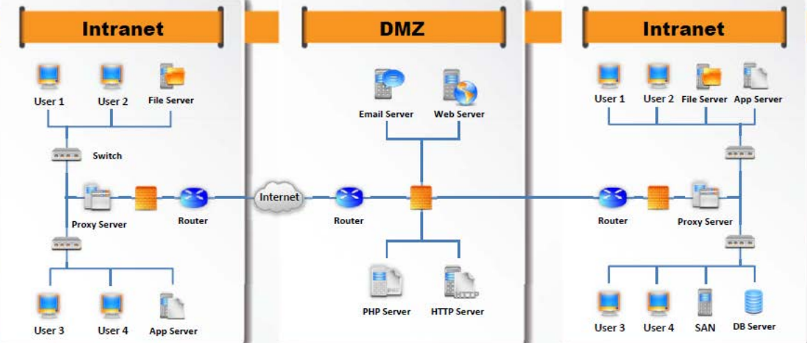
Vulnerability Scanning
Drawing Network Diagrams
Identifies vulnerabilities & weaknesses of a system & network in order to determine the exploitation technique
Network Vulnerabilities
Open Ports & Running Services
Application & Services Vulnerabilities
Application & Services Configuration Errors
Gives valuable information about the network & its architecture
Shows logical or physical path to potential target

Slide 16
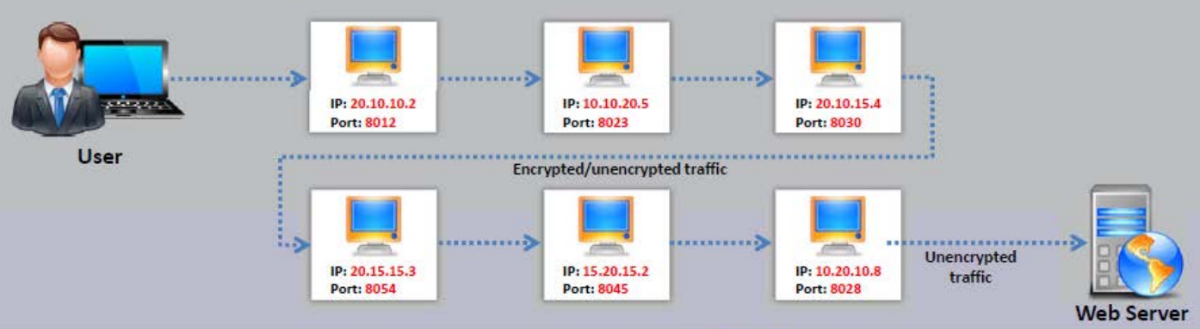
Proxy Servers
An application that can serve as an intermediary for connecting with other computers
Use of Proxy Servers:
To hide the source IP address
To mask the actual source of the attack by impersonating a fake source
To remotely access internets and other off-limit website resources
To interrupt all the requests sent by an user & transmit them to a third destination
To avoid detection by chaining multiple proxy
Proxy Chaining
User requests a resource from the destination
Proxy client at the user’s system connects to a proxy server & passes the request to proxy server
Proxy server strips the user’s identification information & passes the request to next proxy server
This process is repeated by all the proxy servers in the chain
At the end unencrypted request is passed to the web browser
Proxy Tool
TOR
Allows to protect privacy & defend against network surveillance & traffic analysis
CyberGhost
Allows to protect online privacy, surf anonymously & access blocked or censored content

Slide 17
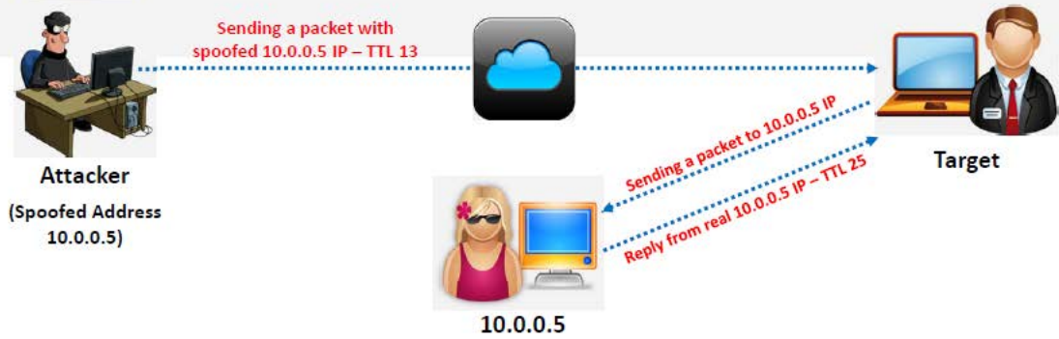
Spoofing IP Address
IP Spoofing Detection Techniques
Changing source IP addresses so that the attack appears to be come from someone else
Reply goes back to the spoofed address but not to the attacker’s real address
Spoofed IP address doesn’t allow complete 3-way handshake & a successful TCP connection
Direct TTL Probes

Slide 18
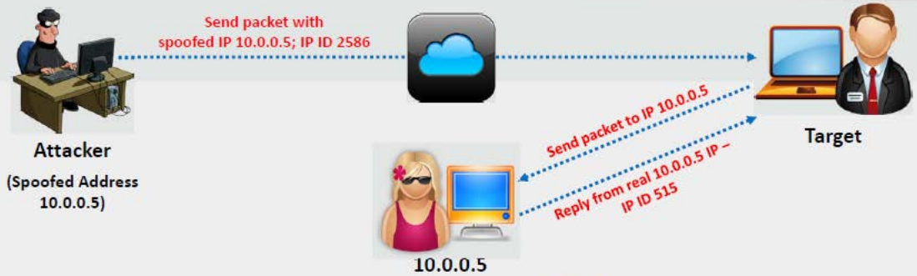
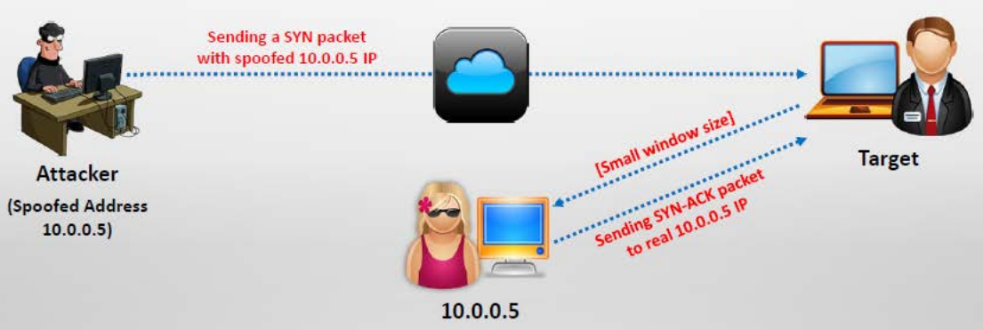
IP Spoofing Detection Techniques
IP Identification Number
TCP Flow Control Method

Slide 19
IP Spoofing Countermeasures
Scanning Pen Testing
Encrypt all network traffic using cryptographic network protocols
Use multiple firewalls providing multi-layered depth of protection
Don’t rely on IP-based authentication
Use random initial sequence number
Ingress Filtering
Filter incoming packets that appear to come from internal IP address
Egress Filtering
Filter all outgoing packets with an invalid local IP address
Determines the network’s security posture by identifying live system, discovering open ports, associating services & grabbing system banners to simulate a network hacking attempt
Help system administrators to:
Close Unused Ports
Disable Unnecessary Services
Hide or Customize Banners
Troubleshoot Service Configuration Error
Calibrate Firewall Rules

Slide 20
Scanning Pen Testing
START
Perform Host Discovery
Perform Port Scanning
Perform Banner Grabbing
Scan for Vulnerability
Draw Network Diagrams
Prepare Proxies
Document all the findings

Slide 21
THE END

